Slide 1
1
Intel Global Impact Festival
Showing the sugar content of black coffee
Han Ka hee: Project Manager
Back You jeong: Data researcher

Slide 2
index
01
Intro
02
Solution
03
Impact
04
Vision
Our table of contents consists of four: intro, solution, impact, and vision.

Slide 3
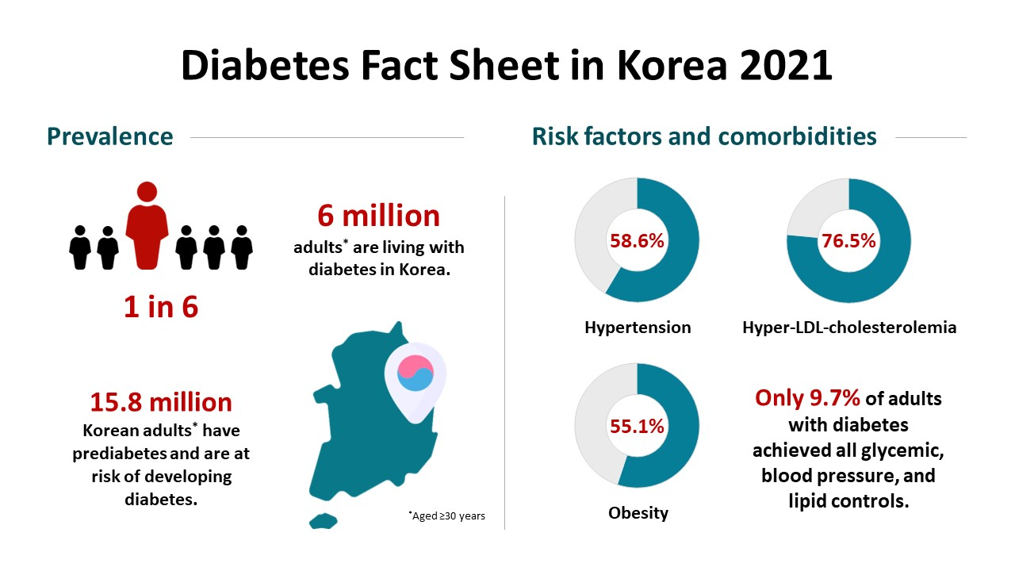
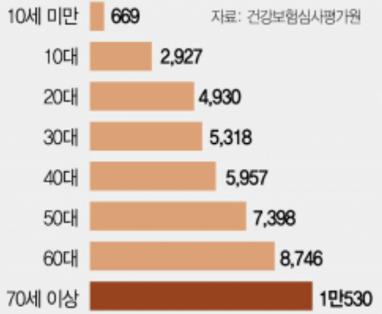
01
Intro
1. Recognize the problem
Enjoy your stylish business and campus life with BIZCAM
Age distribution of type 1 diabetes patients in 2020
Currently, there are more than 6 million adult diabetics in Korea, of which 39.2% are elderly patients aged 65 years or older, and the importance of diabetes management in the elderly is gradually increasing.

Slide 4
01
Intro
1. Recognize the problem
Enjoy your stylish business and campus life with BIZCAM
Age distribution of type 1 diabetes patients in 2020
Nonetheless, diabetes management is at the level of a dead end. Currently, only 1 in 10 patients with diabetes are managed.

Slide 5
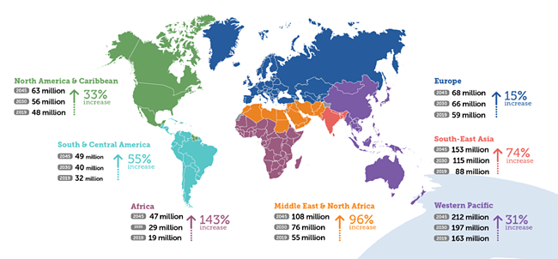
01
Intro
1. Recognize the problem
Enjoy your stylish business and campus life with BIZCAM
Diabetics are increasing rapidly not only in Korea but also around the world.
By 2030, the number of Diabetics aged 65 or older is expected to increase to 195 million, and by 2045, the number is expected to reach 276 million.

Slide 6



01
Intro
1. Recognize the problem
Enjoy your stylish business and campus life with BIZCAM
So, when I worked at a convenience store in a hospital, I saw that elderly people, who are the majority of diabetics, had difficulty checking the ingredient analysis table, so their sugar levels increased when they drank coffee with sugar.

Slide 7
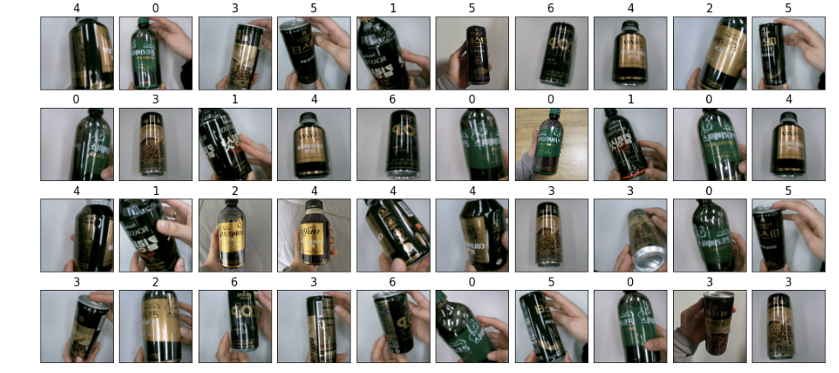
02
Solution
2. Data Acquisition Method
Enjoy your stylish business and campus life with BIZCAM
We obtained data by photographing drinks sold at convenience stores from various angles using a webcam. After taking all the pictures, I saved them in a folder and labeled them.

Slide 8
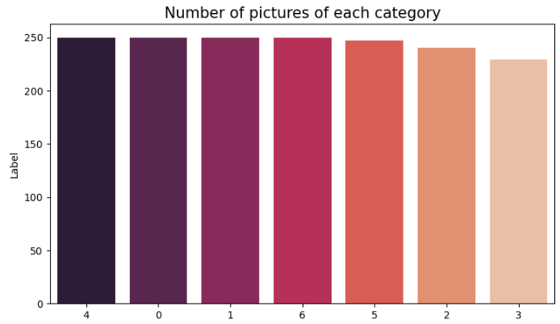
02
Solution
3. How to check data
The data was checked for image data and distributions for label categories using Jupyter Notebook.

Slide 9
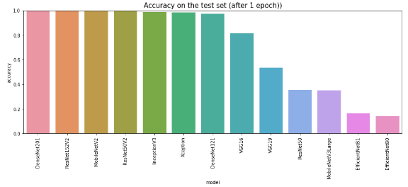
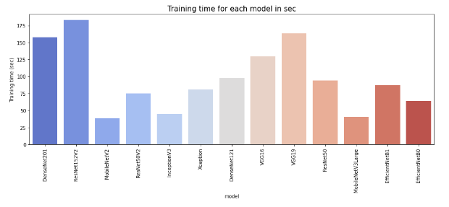

02
Solution
4. AI model selection
Among various classification models, MoblieNetV2 with high accuracy and high speed was selected

Slide 10
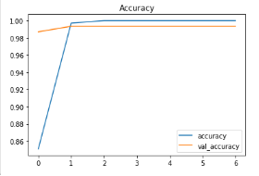
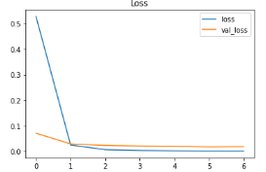
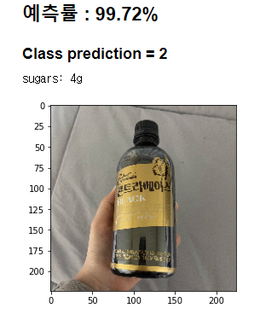
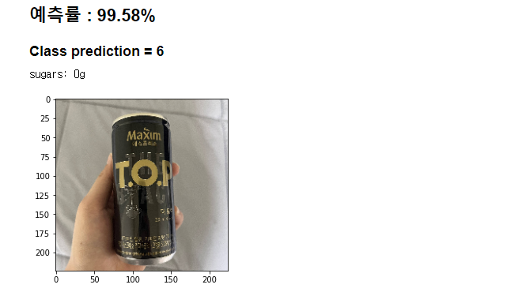
02
Solution
5. How well did the model perform?
The accuracy of the model is high.

Slide 11

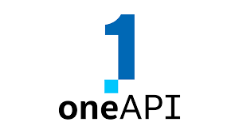
03
Impact
6. What Intel technologies are used in this solution?
What Intel technologies are used in this solution?
We used openVINO, RealSense, Intel i7-8700 CPU, Intel oneAPI from Intel.

Slide 12
03
Impact
6. How can we use our solutions to solve problems?
who | Diabetic patients with presbyopia who need blood sugar control
what | Patients can drink coffee with sugar because they cannot check the sugar
where | When purchasing convenience store coffee
why | Helps manage sugar levels to keep patients healthy
When diabetics purchase Beverage at convenience stores, they cannot check the sugar content on the ingredient analysis table, so they can drink sugary foods.

Slide 13
03
Impact
6. How can we use our solutions to solve problems?
who | Diabetic patients with presbyopia who need blood sugar control
what | Patients can drink coffee with sugar because they cannot check the sugar
where | When purchasing convenience store coffee
why | Helps manage sugar levels to keep patients healthy
By preventing it, patients can help manage their sugar levels and keep their health.

Slide 14


8. What differentiates our solution from existing solutions?
04
Vision
Sugars: 0g
Use Beverage photos classified as AI to display them as big points on the screen

Slide 15
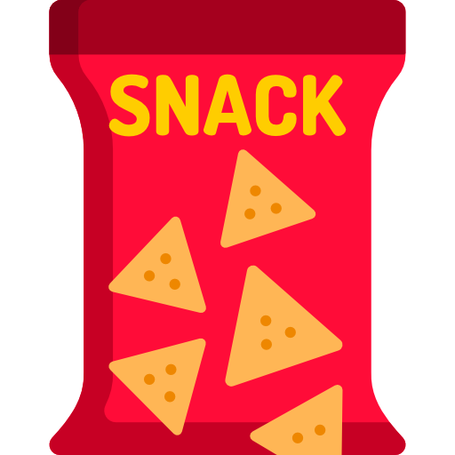
8. What differentiates our solution from existing solutions?
04
Vision
Sodium: 0g
In addition, only changing the data value in this solution can help patients with kidney disease who need sodium control.

Slide 16

8. What differentiates our solution from existing solutions?
04
Vision
Calories: 500kcal
Sodium: 1,760mg
Sugars: 4.6g
Carbohydrate: 77g
Similarly, we can display various information about the food.
We can expand our solution for patients who need diet care.

Slide 17
Thank you

